Slide 1

PROGRAMMING TOOLS AND METHODS FOR MECHATRONICS ENGINEERS
Final project
Done by :
Yusri Taha Al-Sanaani

Slide 2
Presentation Outline
Part 1: Image Enhancement Techniques with Simple Graphical user
interface (GUI )
Brief Literature review
GUI
Part 2: Digital Signal Processing
Moving Average Filter
Part 3: Handwritten Arabic Characters Segmentation (HACS).
Introduction:
Brief Literature review
Methods & Results:
HACS Based on Column Density Variance Analysis
Results & Challenges
Conclusion & Future Work

Slide 3
Image Enhancement Techniques
Image Enhancement is the process of manipulating an image so that the result is more suitable than the original for a specific application.
Image enhancement can be done in :
Spatial Domain
Frequency Domain
Spatial Domain Transformation are :
Point operations
Mask Operations

Slide 4
Point Operation
Operation deals with pixel intensity values individually.
The transformed output pixel value does not depend on any of the neighbouring pixel value of the input image.
Examples:
Image Negative.
Contrast Stretching.
Thresholding.
Brightness Enhancement.
Log Transformation.
Power Law Transformation.

Slide 5
Mask Operation
Mask is a small matrix useful for blurring, sharpening, edge-detection and more.
New image is generated by multiplying the input image with the mask matrix.
The output pixel values thus depend on the neighbouring input pixel values.
The mask may be of any dimension 3X3 4X4 ….

Slide 6
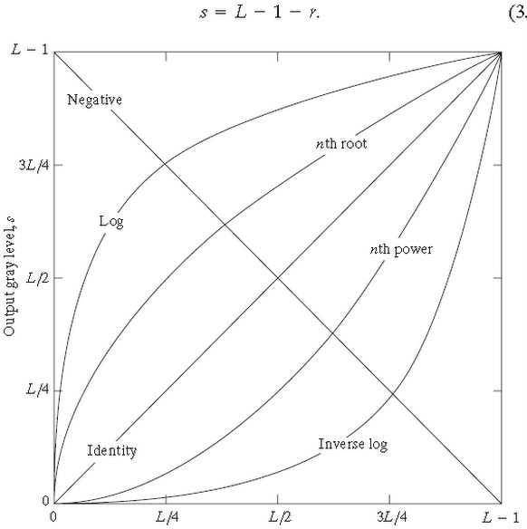
TF for different Intensity Transformations
Transfer function of
Negative
Log
Nth power γ <1
Identity
Nth power γ >1
Inverse log

Slide 7
Image Negative
Negative images are useful for enhancing white or grey detail embedded in dark regions of an image.
The negative of an image with gray levels in the range [0,L-1] is obtained by using the expression
s = L -1 - r
L-1 = Maximum pixel value (255).
r = Pixel value of an image.

Slide 8
Contrast Stretching
Contrast basically the difference between the intensity values of darker and brighter pixels .
Contrast stretching expands the range of intensity levels in an image.
Contrast stretching is done in three ways:
Multiplying each input pixel intensity value with a constant scalar.
Example: s=5*r
Using Histogram Equivalent
Applying a transform which makes dark portion darker by assigning slope of < 1 and bright portion brighter by assigning slope of > 1.

Slide 9
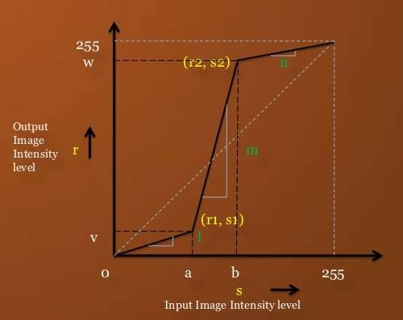
Contrast Stretching
Formulation is given below:
s = l*r ; for 0 <= r <= a
= m(r-a) + v ; for a < r <= b
= n(r-b) + w ; for b < r

Slide 10
Thresholding
Thresholded image has maximum contrast as it has only BLACK & WHITE gray values.
In Contrast Stretching figure, if l & n slope are made ZERO & if m slope is increased then we get Thresholding Transformation

Slide 11
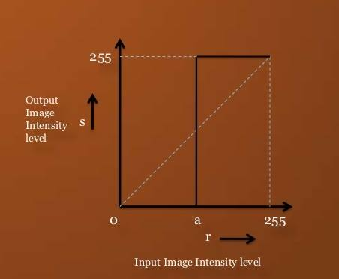
Thresholding Function
Expression goes as under:
s = 0; if r <= a
s = L – 1 ; if r >a
where, L is number of gray levels.

Slide 12
Log Transformation
The log transformation is given by the expression
s = c log(1 + r)
where c is a constant and it is assumed that r≥0.
This transform is used to expand values of dark pixels and compress values of bright pixels.

Slide 13
Power Law Transformation
Expression for power law transformation is given by:
s = c *(r ^{γ} )
s is the output pixels value , r is the input pixel value ,c and γ are real numbers.
For various values of γ different levels of enhancements can be obtained.
The difference between the log-transformation function and the power-law functions is that using the power-law function a family of possible transformation curves can be obtained just by varying the γ .

Slide 14
Average Filter
The output (response) of a smoothing, linear spatial filter is simply the average of the pixels contained in the neighborhood of the filter mask.
The idea behind smoothing filters is straightforward. By replacing the value of every pixel in an image by the average of the gray levels in the neighborhood defined by the filter mask, this process results in an image with reduced “sharp” transitions in gray levels.

Slide 15
Median Filter
median filter replaces the value of a pixel by the
median of the gray levels in the neighborhood of that pixel (the original value of the pixel is included in the computation of the median).
Median filters are quite popular because they provide excellent noise-reduction capabilities, with considerably less blurring than average filter of similar size.

Slide 16
Median Filter
The image processed with the median filter has less visible noise, but the price paid is significant blurring.
In general, median filtering is much better suited than averaging for the removal of additive salt-and-pepper noise

Slide 17
Laplacian Filter
The Laplacian operator is an example of a second order or second derivative method of enhancement.
It is particularly good at finding the fine details in an image.
one application of a Laplacian operator is to restore fine detail to an image which has been smoothed to remove noise.

Slide 18
DSP-Moving Average Filter

Slide 19
Moving Average Filter(MAF)
The moving average technique is used to remove the high frequency noise and oscillations from a recorded signal, by finding the actual lower frequency that’s underlying the added noise.
The MAF is the most common filter in DSP, mainly because it is the easiest digital filter to understand and use.

Slide 20
Moving Average Filter(MAF)
In spite of its simplicity, the moving average filter is optimal for a common task:
reducing random noise while retaining a sharp response.
This makes it the common filter for time domain encoded signals.

Slide 21

Moving Average Filter(MAF)
For a signal x(n) with M data points, the general form of the look-backwards moving averaging window is:
Where 𝑁≤𝑘≤𝑀, y(k) is the new filtered signal, x(n) is the original signal, N is the size of the window.

Slide 22
References:
Digital Image Processing by Gonzalez And Woods.
Matlap Programming for Engineers by Stephen J. Chapman.
Matlab Help

Slide 23
THANK YOU

